Slide 1
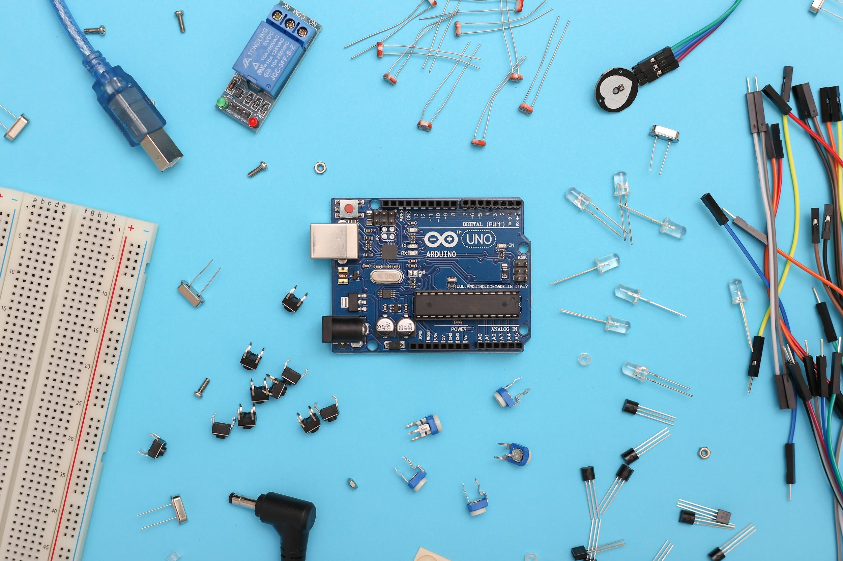
Public Bus Automation
A Microcontroller based System Design Project

Slide 2
CSE 3216
Microcontroller Based System Design Lab
Ahsanullah University of Science & Technology
Dr. Md. Raqibul Hasan
Assistant Professor, Dept. of CSE, AUST
Mr. Farzad Ahmed
Lecturer, Dept. of CSE, AUST
Presented to
190104041 Md. Rafi
190104042 Most. Sadia Salsabil
190104043 Jerin Ahasan Kheya
190104044 Md. Nabil Rahman Khan
Presented by
A2G4
CSE3216 | Microcontroller Based System Design Lab | AUST
2
Presented by

Slide 3
Objectives
Provide an automated door system
Make an automatic system which will charge accurate fares
Discount half fare for the students
Live tracking to the bus
Minimize passenger as well as bus stuff’ sufferings
A2G4
CSE3216 | Microcontroller Based System Design Lab | AUST
3

Slide 4
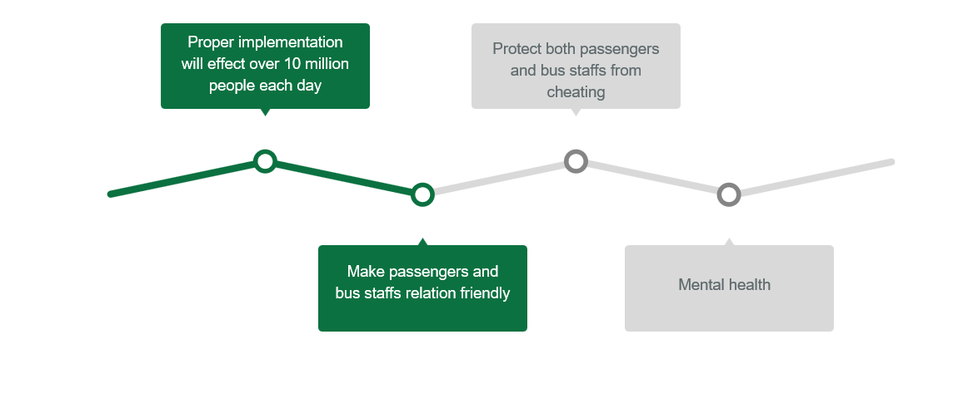
Social Values
A2G4
CSE3216 | Microcontroller Based System Design Lab | AUST
4

Slide 5
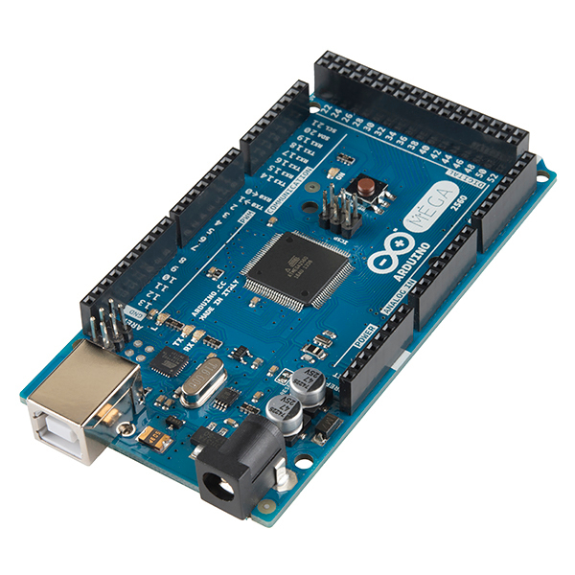
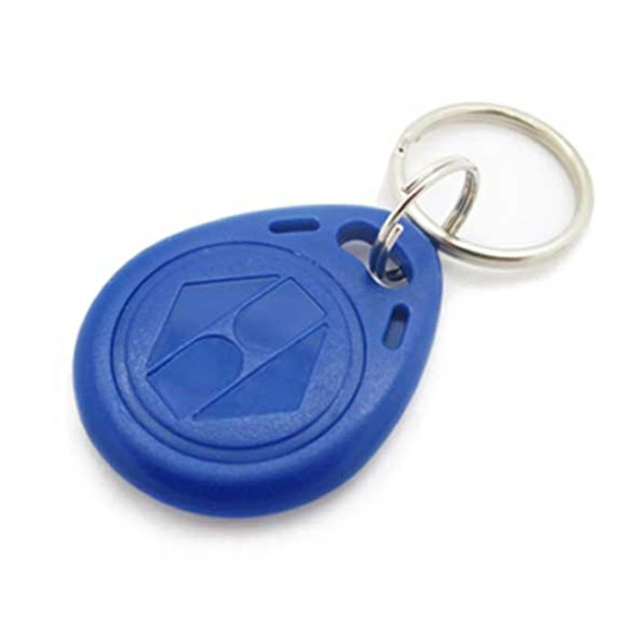
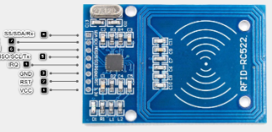
Required Components
Arduino mega 2560 r3
MFRC-522 RFID Module
RFID Tag (125KHz)
A2G4
CSE3216 | Microcontroller Based System Design Lab | AUST
5

Slide 6
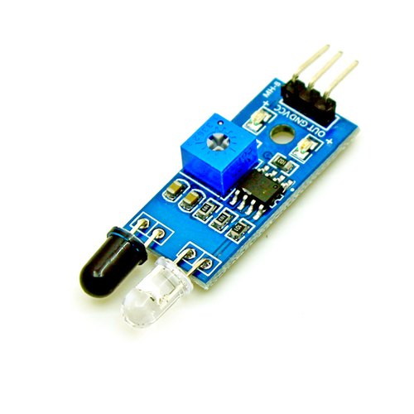
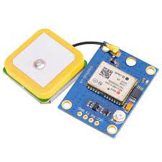
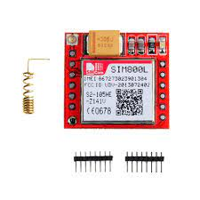
Required Components
GPS Module GY-NEO-6M V2
SIM800L GSM/GPRS Module
IR Infrared Obstacle Avoidance Sensor Module
A2G4
CSE3216 | Microcontroller Based System Design Lab | AUST
6

Slide 7
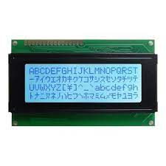
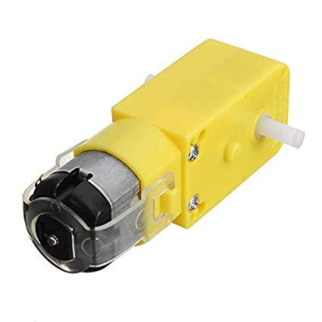
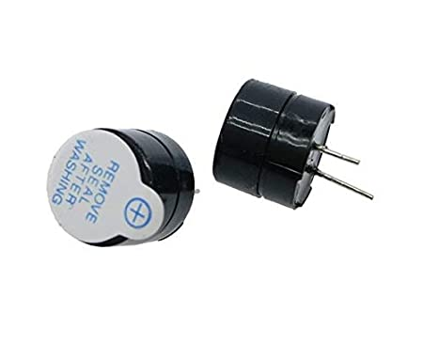
Required Components
Gear Motor
Buzzer
LCD2004 20X4 LCD Display
A2G4
CSE3216 | Microcontroller Based System Design Lab | AUST
7

Slide 8
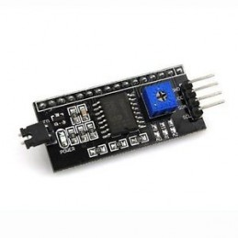
Required Components
I2C LCD Adapter Module
A2G4
CSE3216 | Microcontroller Based System Design Lab | AUST
8

Slide 9
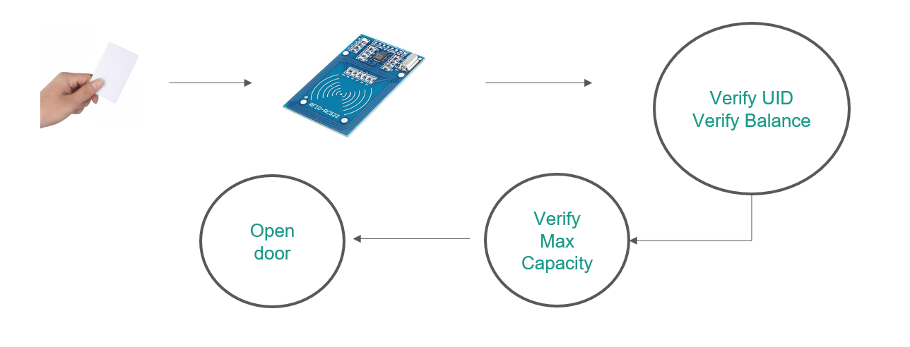
Working Procedure
A2G4
CSE3216 | Microcontroller Based System Design Lab | AUST
9

Slide 10
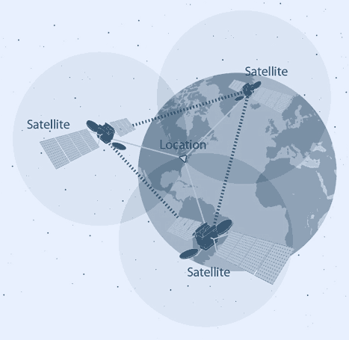
Working Procedure
Distance Travelled by Passenger
=
Distance Travelled by Bus at the time of passenger leaving
-
Distance Travelled by Bus at the time of passenger entering
A2G4
CSE3216 | Microcontroller Based System Design Lab | AUST
10

Slide 11





Working Procedure
Passenger send “get location” SMS to the bus
SIM800L GSM Sensor Receive the SMS
Arduino Recognize the Command in the SMS
Get Latitude and Longitude
Reply Google Maps link of the current location with latitude and longitude
A2G4
CSE3216 | Microcontroller Based System Design Lab | AUST
11

Slide 12

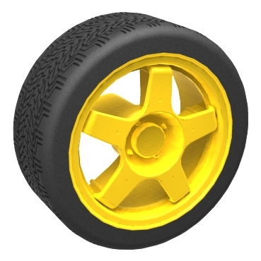

Working Procedure
A2G4
CSE3216 | Microcontroller Based System Design Lab | AUST
12

Slide 13
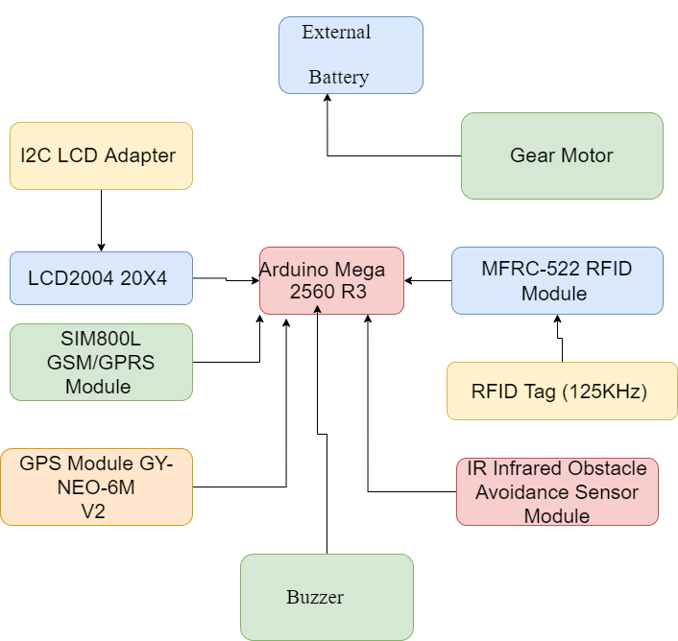
Block Diagram
Figure: Block diagram of Smart Chicken Farm
CSE3216 | Microcontroller Based System Design Lab | AUST
13

Slide 14
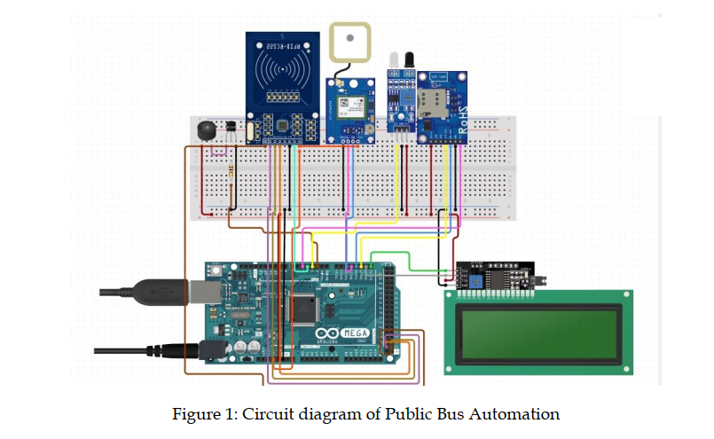
Circuit Diagram
A2G4
CSE3216 | Microcontroller Based System Design Lab | AUST
14

Slide 15
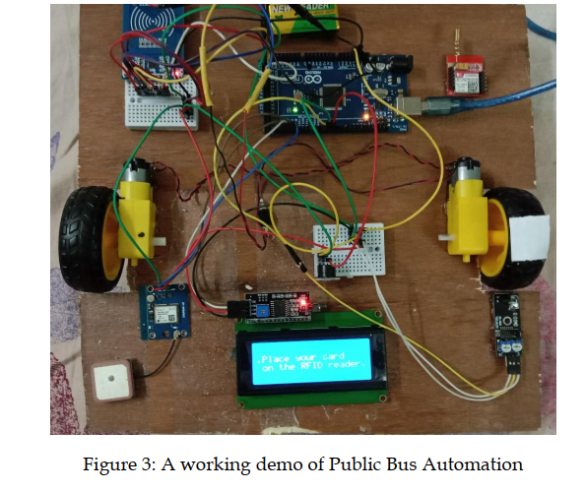
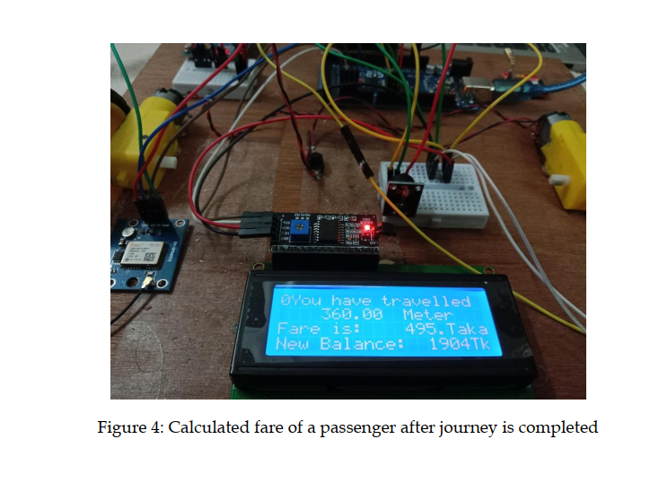
Project Images
A2G4
CSE3216 | Microcontroller Based System Design Lab | AUST
15

Slide 16
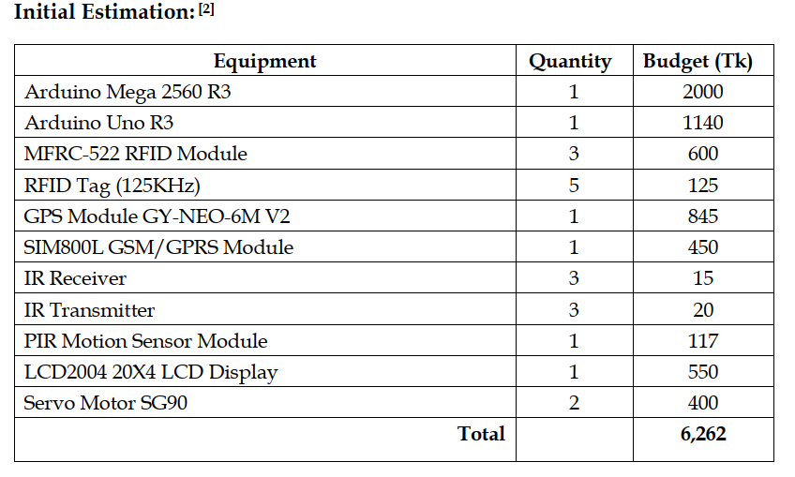
Budget Comparison
A2G4
CSE3216 | Microcontroller Based System Design Lab | AUST
16

Slide 17
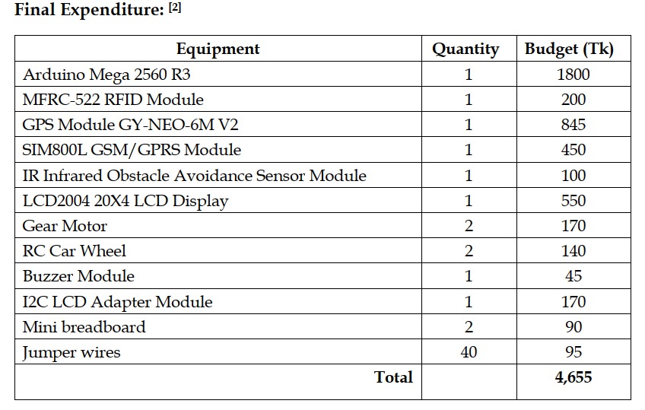
Budget Comparison
A2G4
CSE3216 | Microcontroller Based System Design Lab | AUST
17

Slide 18
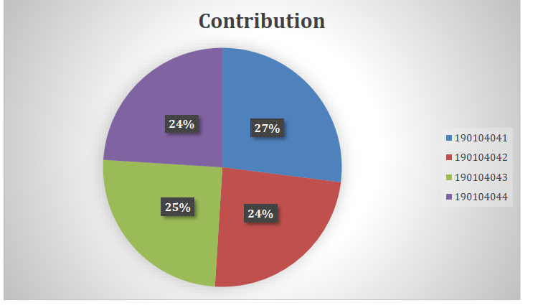
Contribution of Team Members
A2G4
CSE3216 | Microcontroller Based System Design Lab | AUST
18

Slide 19
Challenges of our Project
The Sim-Kit is not getting connected.
GPS module cannot send signals properly if there are obstacles Between it and the satellite.
Automatic mode switching from GPS to wheel revolution was not possible.
Unable to connect database with Arduino
A2G4
CSE3216 | Microcontroller Based System Design Lab | AUST
19

Slide 20
Conclusion
Automates various activities
Reduces workload
Decreases human error
Increases net profit
Bus staff and passengerrs will no longerr bargain over rates.
improves the travel experience for both passengers
A2G4
CSE3216 | Microcontroller Based System Design Lab | AUST
20

Slide 21
Reference
1. Circuit Diagram, https://www.circuito.io/app?components=9442,11061,316349,417987,7619 81,811437,956215,975601, Created and accessed September 6, 2022 2. All prices collected from https://store.roboticsbd.com/, Last accessed September 6, 2022
A2G4
CSE3216 | Microcontroller Based System Design Lab | AUST
21

Slide 22
Thank you
A2G4
CSE3216 | Microcontroller Based System Design Lab | AUST
22

